Slide 1
HR ANALYTICS PROJECT
Employee Attrition & Workforce Insights
BY
LAWAL MARY

Slide 2
Project Overview
• Goal: understand employee attrition patterns and identify workforce factors associated with employees leaving.
• Dataset: IBM HR Analytics Employee Attrition dataset with 1,470 employees and 44 columns.
• Workflow: data inspection and preparation in Excel & Python → exploratory analysis and correlation review → interactive Excel dashboard.
• The dashboard brings the analysis together through KPIs, demographic views, department/job-role analysis, age-group analysis and filters.
2

Slide 3
Executive Summary
Headline metrics from the completed dashboard
1,470
Total Employees
237
Employees Lost
1,233
Active Employees
16.12%
Attrition Rate
37
Average Age
• Most employees remained with the organization, but a meaningful minority exited.
• Attrition is concentrated in specific departments, job roles, age groups and work conditions rather than being evenly distributed.
• The dashboard is designed to help HR move from raw employee records to targeted retention questions.
3

Slide 4
Key Findings
Department
Research & Development has the largest employee population and also records the highest number of employees who left.
Overtime
Employees working overtime show more attrition, while employees without overtime are more represented among those who stayed.
Job Role
Sales Executive has the largest employee population, while Laboratory Technician records the highest number of employees who left.
Income
Higher-income employees tend to stay more, while lower-income employees show greater attrition in the analysis.
Age
Younger employees tend to leave more, while older employees tend to show stronger retention.
4

Slide 5
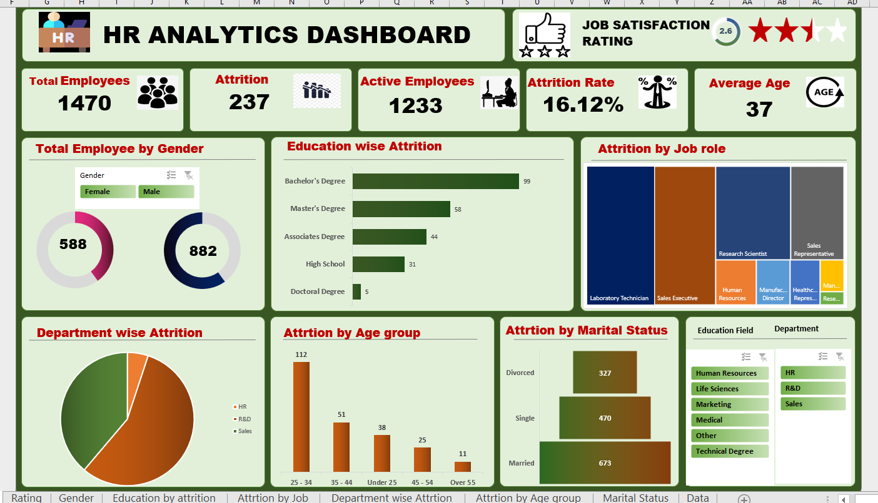
Interactive HR Analytics Dashboard
Completed Excel dashboard
5

Slide 6
Dashboard Structure
• KPI layer: Total Employees, Attrition, Active Employees, Attrition Rate and Average Age.
• Demographic layer: gender, education, age group and marital status.
• Workforce layer: department and job-role attrition.
• Filter layer: Education Field and Department filters allow focused exploration.
• The dashboard is intended for quick executive scanning while still allowing deeper investigation.
6

Slide 7
Correlation Analysis
• The correlation review was used as an exploratory step to identify variables that move with the attrition outcome.
• Among the strongest positive relationships observed were Overtime, Marital Status and Distance From Home.
• Among the most negative relationships observed were Total Working Years, Job Level and Years in Current Role.
• These relationships should be interpreted as associations, not proof that a variable directly causes employees to leave.
7

Slide 8
Recommendations
• Review overtime-heavy roles and teams for workload, scheduling and burnout risks.
• Develop targeted retention strategies for younger employees and early-career roles.
• Investigate the experience of high-attrition job roles such as Laboratory Technician and Sales Executive.
• Review compensation progression and career growth opportunities, especially for lower-income and early-tenure employees.
• Use department-level attrition monitoring to identify teams that need deeper HR intervention.
8

Slide 9
Conclusion
The HR Analytics project transforms employee-level data into a practical view of attrition.
The completed dashboard highlights where attrition is concentrated and provides a foundation for targeted retention decisions.
9

